Slide 1



Introduction
Good morning, respected teacher and dear classmates.
Student full name: MardonAli Fayzullayev
Student ID: 230423 | CS2
Noise Removal
Today I will present my project titled:
“Noise Removal in Medical Images.”

Slide 2
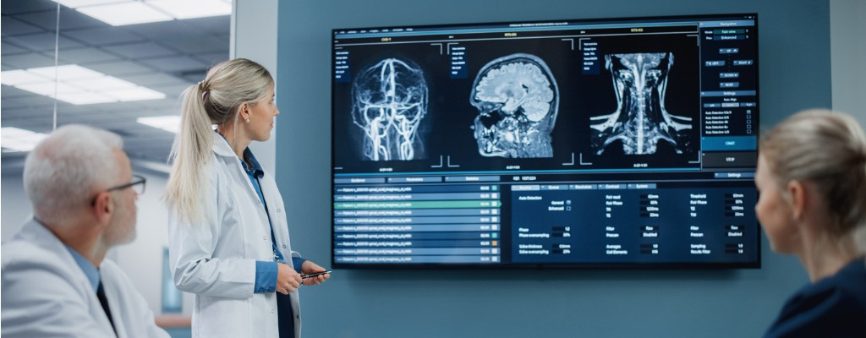
Background
Background to Noise Removal
Nowadays, medical imaging such as MRI and CT scans plays a very important role in healthcare.
Doctors rely on these images to
diagnose diseases.
However, these images often contain noise, which reduces their quality.
This noise can hide important details and make analysis more difficult.

Slide 3

Problem
Statement
Problem Statement
The main problem is that medical images often contain noise.
This noise is caused by imaging devices, environment, or transmission errors
It reduces the overall image quality and clarity
Important small details may be hidden or distorted
Edges and boundaries become less visible
This makes it difficult for doctors to analyze the image correctly
As a result, noise can negatively affect diagnosis and decision-making.
Therefore, it is very important to remove noise while preserving important image details.

Slide 4
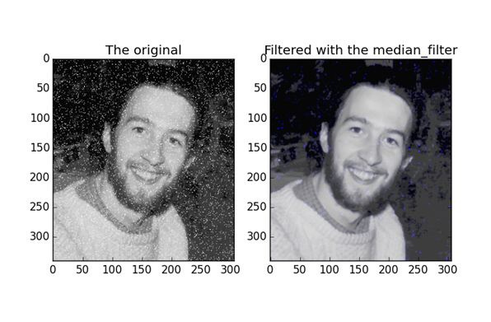
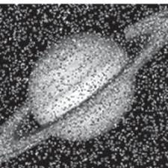
Objective + Solution
Objective +
Solution
The main objective of this project is to remove noise from medical images and improve their quality.
To solve this problem, I will use two filtering techniques:
Gaussian filter
Median filter
These filters will be applied and their results will be compared.

Slide 5
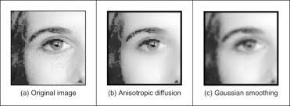
Gaussian Filter
Gaussian Filter
IT REDUCES NOISE BY BLURRING THE IMAGE
The Gaussian filter is a smoothing
technique.
IT IS USEFUL FOR GENERAL SMOOTHING
IT PRESERVES EDGES BETTER
IT BLURS IMPORTANT EDGES
However, it has some disadvantages:
SOME DETAILS MAY BE LOST
So it is not always the best solution.

Slide 6
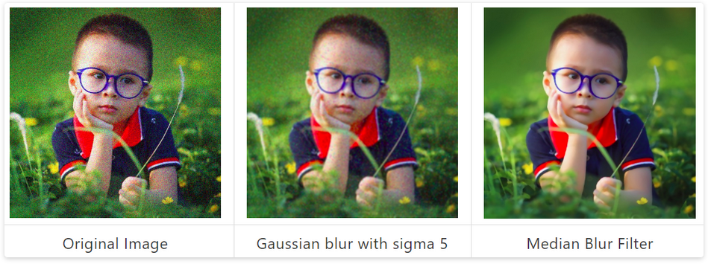
Median Filter
Median Filter
IT REPLACES EACH PIXEL WITH THE MEDIAN VALUE OF ITS NEIGHBORS
The Median filter is very effective for noise removal.
IT REMOVES NOISE EFFICIENTLY
IT REMOVES SMALL VARIATIONS
KEEPS IMPORTANT DETAILS
Advantages:
PRODUCES CLEARER IMAGES
That is why it is often better than Gaussian filtering.

Slide 7
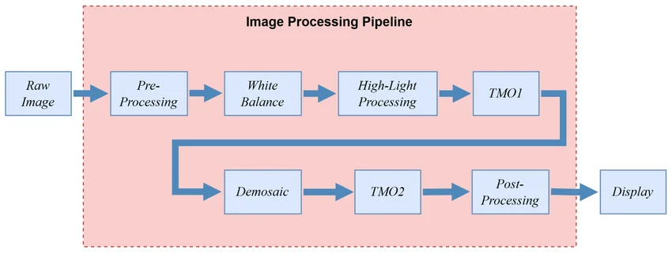
Methodology
Methodology
The project follows these steps:
LOAD THE INPUT IMAGE
PERFORM PREPROCESSING IF NEEDED
APPLY GAUSSIAN FILTER
APPLY MEDIAN FILTER
DISPLAY THE RESULTS
COMPARE AND ANALYZE THE OUTPUTS
This process helps evaluate the performance of both methods.

Slide 8
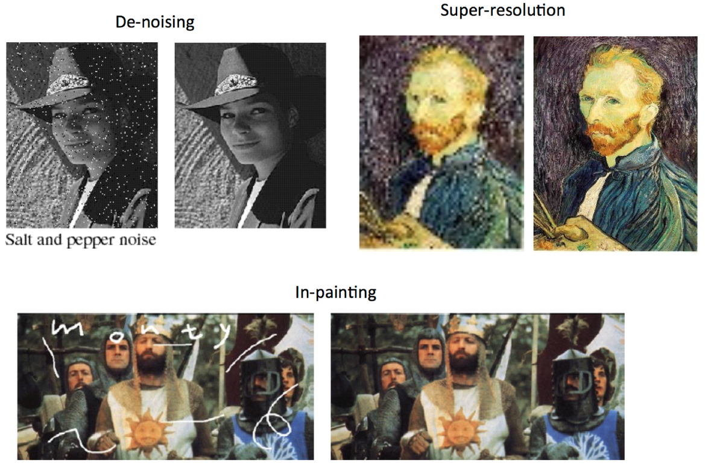
Analysis
The analysis will focus on:
Improvement in image quality
Amount of noise reduction
Preservation of edges
Based on these factors, the performance of each filter will be evaluated.
Dataset + Results
Dataset and Results
In this project, I will use:
MRI or CT images
JPG or PNG format
Several sample images
Expected results:
Cleaner images
Outputs from both filters
Clear comparison between them
This will help identify the better method

Slide 9
Applications and Limitations
Applications
Limitations
This project can be used in:
Medical diagnosis
Computer vision systems
Image preprocessing for AI
Surveillance and enhancement systems
It has important real-world applications.
There are some limitations:
Small dataset
Only basic filtering techniques are used
No advanced AI or deep learning
Results may not be perfect in all cases

Slide 10
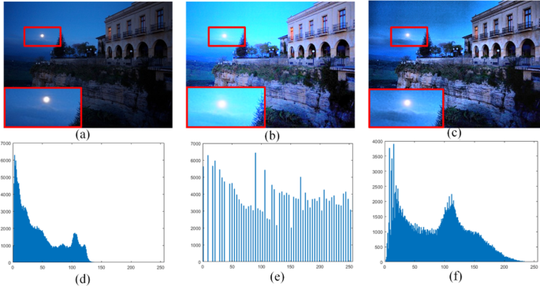
Conclusion
In conclusion, this project improves medical image quality by removing noise.
I used Gaussian and Median filters and compared their performance.
The results show that the Median filter performs better because it preserves important details.
Overall, this project demonstrates how simple image processing techniques can significantly improve image quality.
In the future, this work can be extended by using more advanced methods such as adaptive filters or deep learning techniques for even better results.

Slide 11
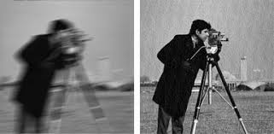



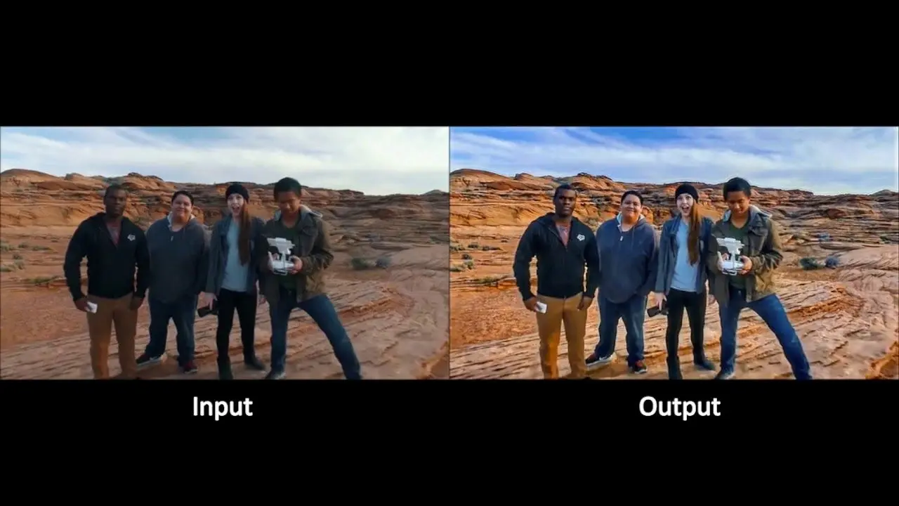
Noise Removal in Medical Images
Thank You
+998 95 032 56 02
for your attention.
www.researchgate.com
@alifayzullayev@gmail.com

